Slide 1
The relationship between economic development and female labour force participation: A within-country analysis of Mexico
Isaac Lopez Moreno Flores
isaac.lopezmorenoflores@manchester.ac.uk

Slide 2
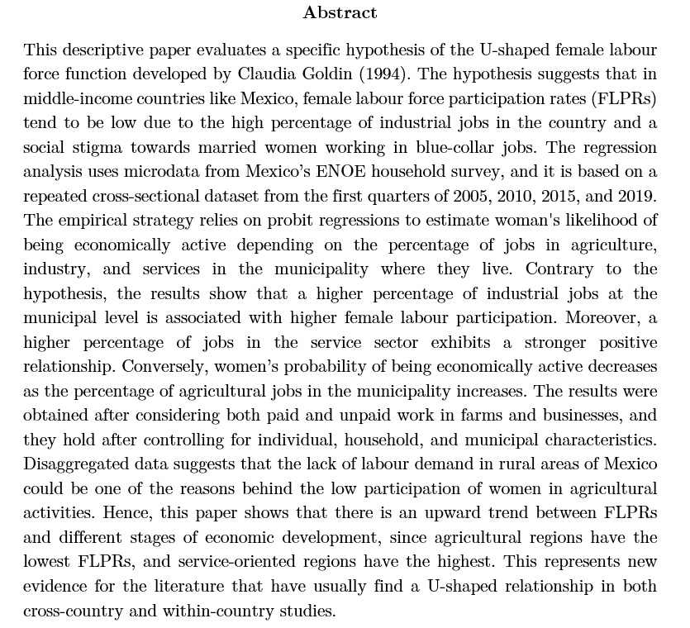

Slide 3
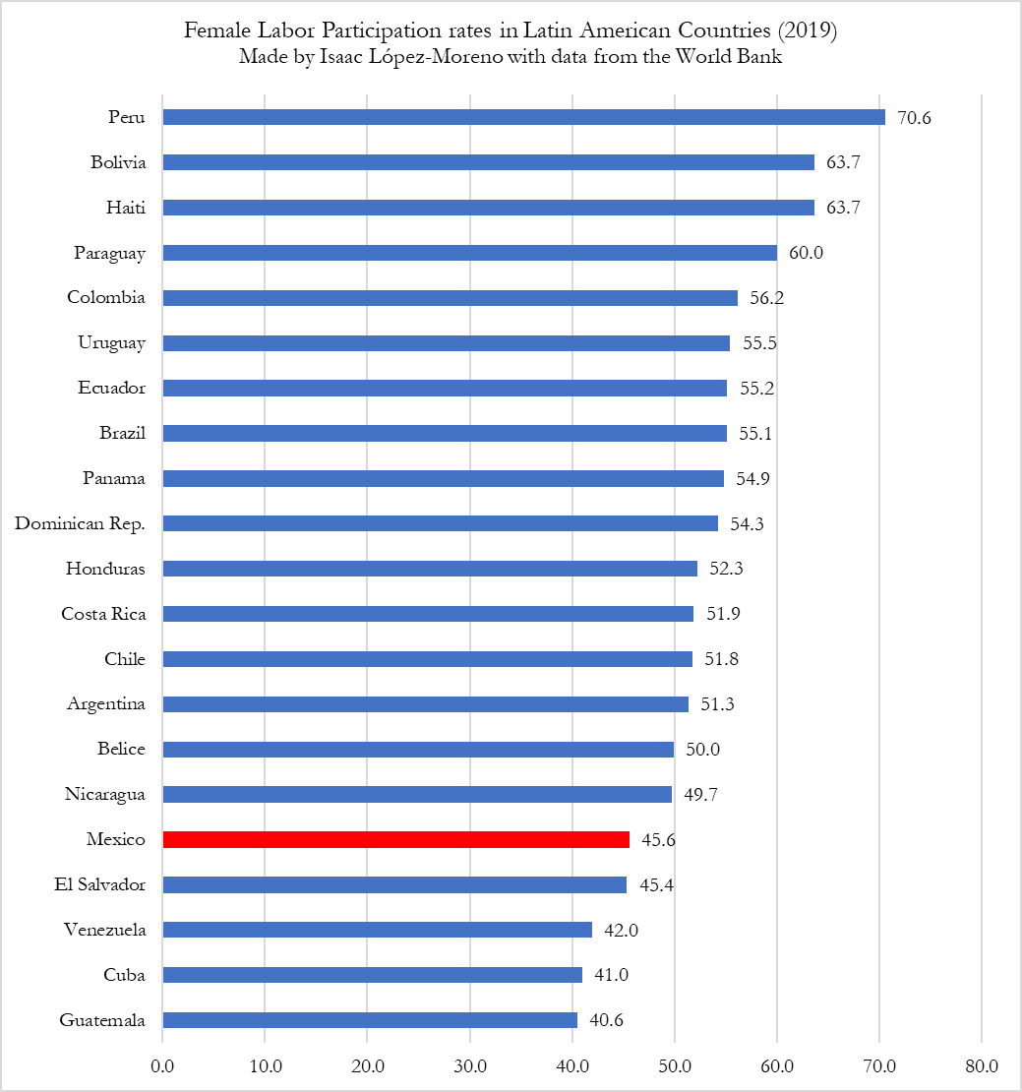
Research Problem
Mexico has one of the lowest female labour participation rates among Latin-American countries.

Slide 4
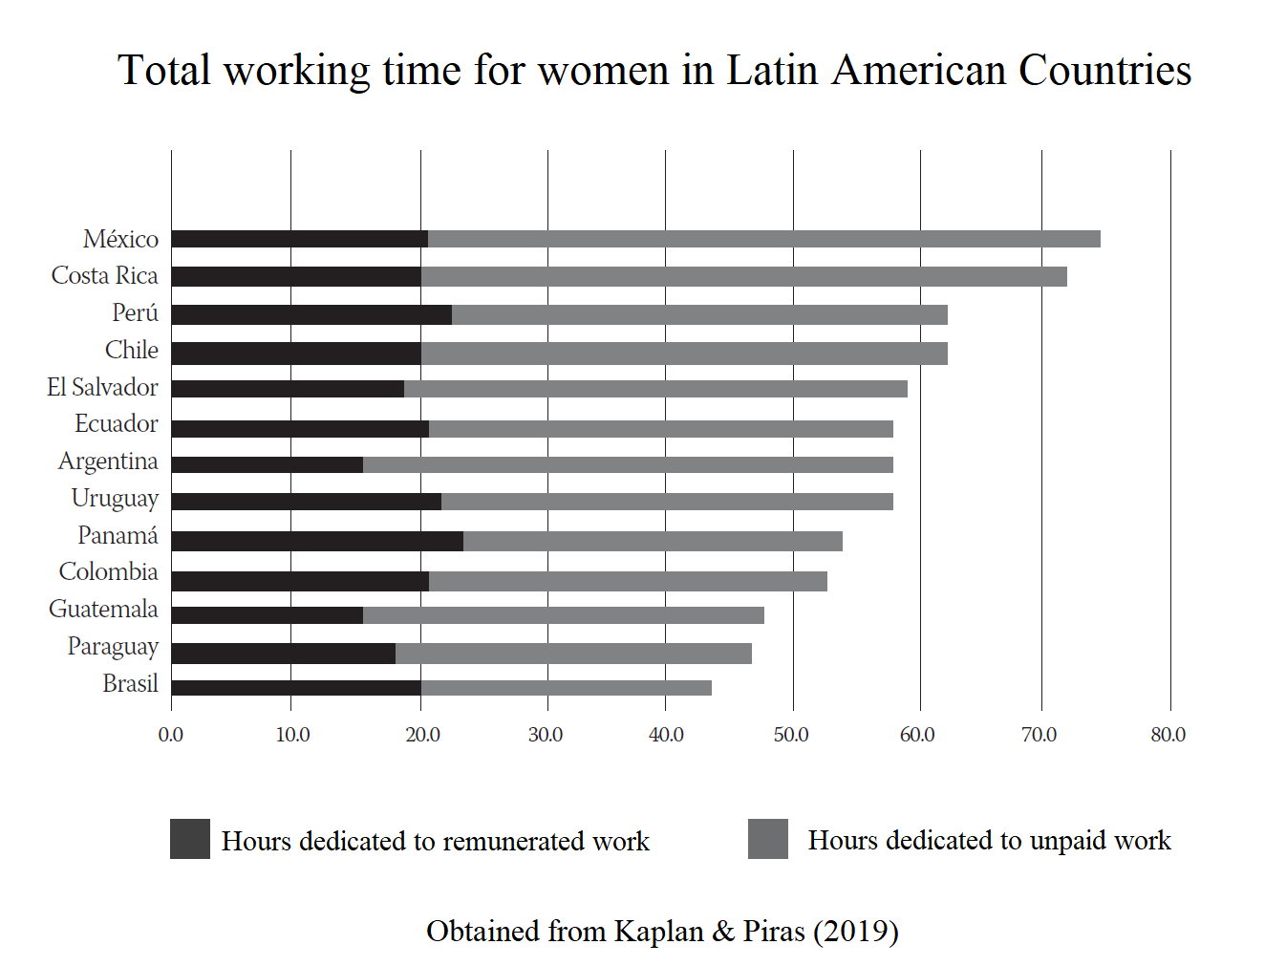
Research Problem
Moreover, Mexican women dedicate the highest number of hours to unpaid work in the whole region.

Slide 5
Research Problem
On the other hand, Mexico is the Latin-American country with the highest percentage of jobs in the industrial sector.
Source: World Bank, World Development Indicators Employment in industry (% of total employment).

Slide 6
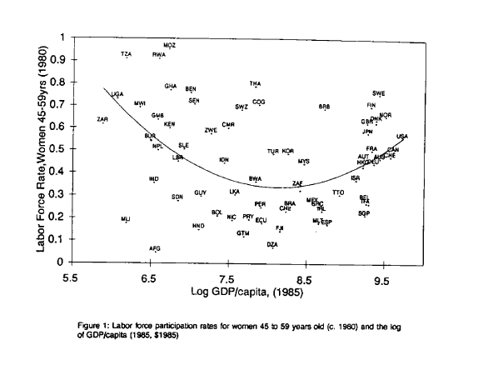
Literature Review
Claudia Goldin (1994) found a U-shaped curve between log gdp per capita and female labour participation rates across countries.
Source: Goldin (1994)

Slide 7
The U-shaped feminization hypothesis
According to Goldin’s (1994) theory,
FLPRs tend to be high in agricultural countries,
FLPRs experience a decline in industrial countries,
FLPRs rise again in service-oriented countries.

Slide 8
The U-shaped feminization hypothesis
She developed a theory of how different factors play a role in the U-shaped pattern observed across countries.
Structural transformation process
Fertility rates
Educational attainment
Marital status
Sociological factors
Cultural factors

Slide 9
The U-shaped feminization hypothesis
High FLPRs in low-income countries due to:
Dominant agricultural sector
Manual labour in agriculture
Lack of agricultural machinery
High labour demand
Low salaries and low productivity
High fertility rates
High dependency ratio
Compatibility of jobs in family farms with child rearing responsabilities

Slide 10
The U-shaped feminization hypothesis
Decline of FLPRs in middle-income countries due to:
Expansion of the industrial sector
Several blue-collar jobs available
Social stigma towards married women in blue collar jobs
Strong Income effect
Weak substitution effect
Complex demand-effect driven by agricultural machinery
Gender gaps in education
Employers’ preferences or discrimination against women
Husbands’ or wives’ request to not engage in physically demanding jobs
Incompatibilty of FLP in industry + child rearing

Slide 11
The U-shaped feminization hypothesis
Rise of FLPRs in high-income countries due to:
Expansion of the service sector.
Several white-collar jobs available
No social stigma towards white-collar jobs
Strong substitution effect Weak income effect
No gender gaps in education
Female achieved higher levels of education
Job flexibility
Lack of physically demanding jobs

Slide 12
Literature review
Several researchers found evidence to support Goldin’s theory:
Cagatay & Özler (1995)
Mammen & Paxson (2000)
Clark, York, and Anker (2003)
Luci (2009)
Tam (2011)
Verick (2014)
Olivetti (2013)
Heath & Jayachandran (2017)

Slide 13
Literature review
Gaddis & Klasen (2014) critized and challenged the results of some of the previously studies by criticizing the databases, the empirical strategies and the econometric techniques implemented in their analyses.

Slide 14
Literature review
One of the criticisms of Gaddis & Klasen (2014) is that some of the previous studies are just a simple cross-sectional correlation between FLPRs and GDP per capita as a proxy of economic development.

Slide 15
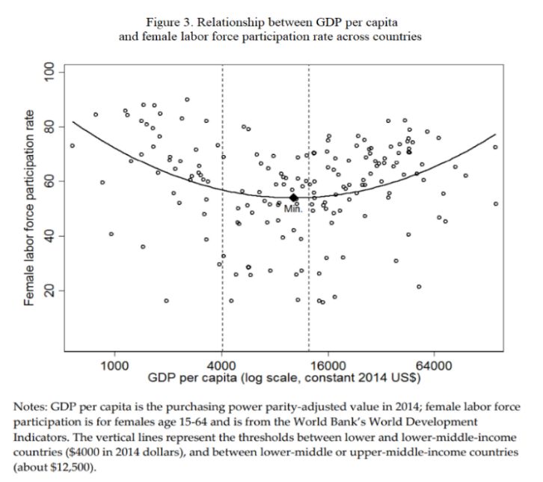
Obtained from Heath & Jayachandran (2017)

Slide 16
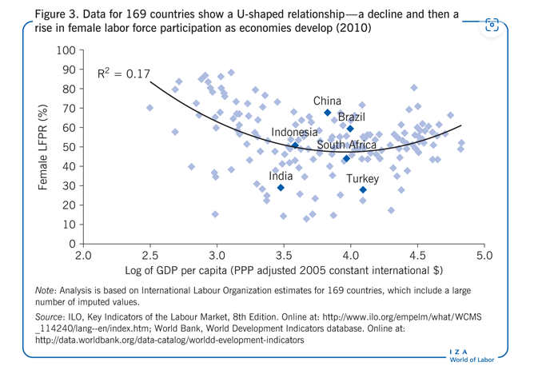
Obtained from Verick (2014)

Slide 17
Literature review
They also mentioned that estimates of GDP per capita adjusted at purchasing power parities (PPP) have large margins of error, so they should not be used to make empirical evaluations of the U-shaped feminization hypothesis.
Instead of using gdp per capita, Gaddis & Klasen (2014) used sector-specific growth in value added and employment to capture structural change.

Slide 18
Literature review
Their results indicated that changes in sector-specific growth in agriculture, industry and services have different effects on FLPRs, but that they are particularly small in magnitude, so they concluded that there is little evidence to consider them as key drivers of FLPRs.

Slide 19
Literature review
Gaddis & Klasen (2014) mentioned that other researchers could consider that using sectoral growth could bias the coefficients towards zero.
They argued that their data is “at least as problematic” as the data that had previously been used in other studies to test the U-shaped feminisation hypothesis.

Slide 20
Research questions
Do Mexican regions with a higher percentage of industrial jobs have the lowest female labour force participation rates?
Do Mexican women living in regions with a high percentage of industrial jobs have a lower likelihood of being part of the workforce?

Slide 21
Contribution to the literature
This is a within-country study of Mexico in a research topic that tends to be addressed by making cross-country analysis.
This study uses microdata obtained from household surveys that offers a high level of disaggregation. (Compared to aggregated data in time-series).
Instead of using gdp per capita, or sector-specific growth, this paper uses sectoral distribution of employment to captures both the level of economic development and the structural transformation over time.

Slide 22
Contribution to the literature
The sectoral distribution of employment captures three variables:
Percentage of jobs in agriculture
Percentage of jobs in industry
Percentage of jobs in services
The sum of these three variables is always equal to 100.

Slide 23
Cross-country analysis

Slide 24
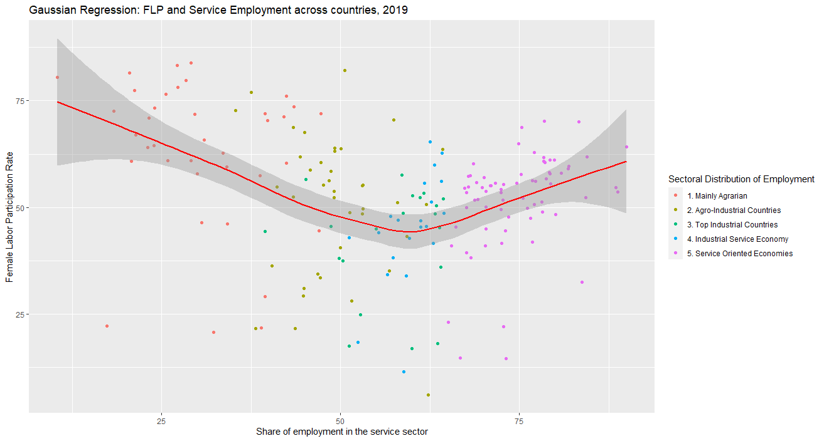
Mexico

Slide 25
Within-country analysis

Slide 26
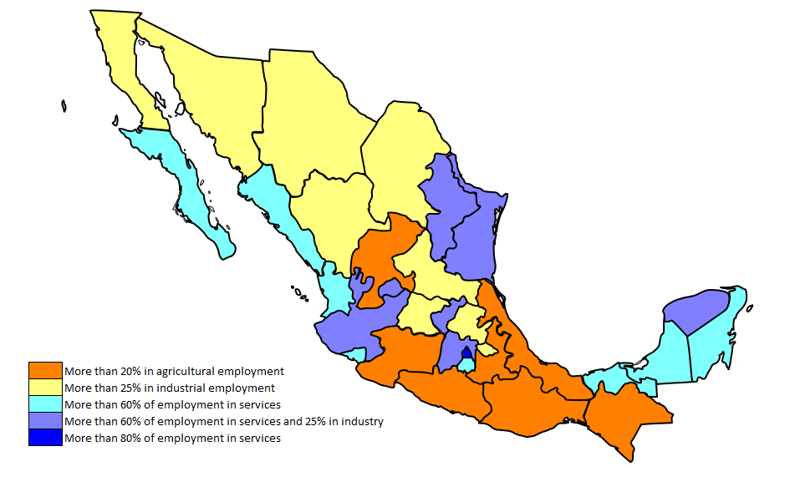
Map of sectoral distribution of employment in Mexican states (1st quarter of 2019)

Slide 27
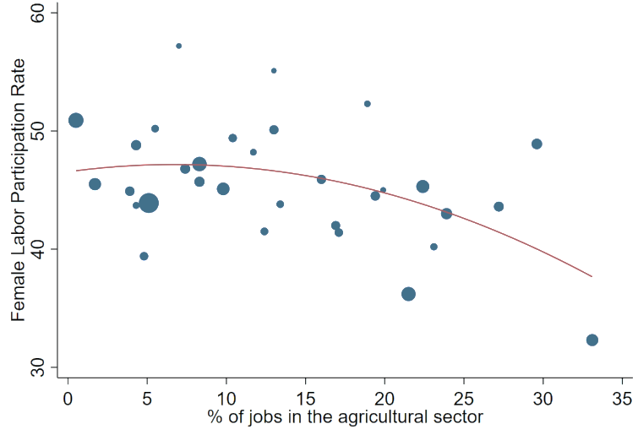
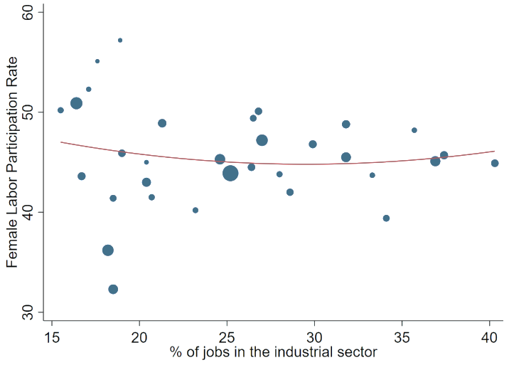
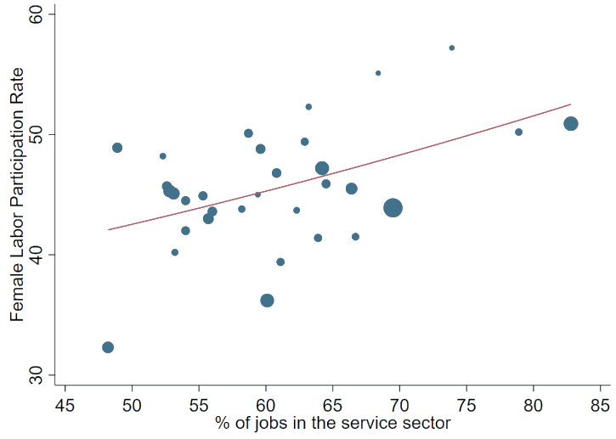
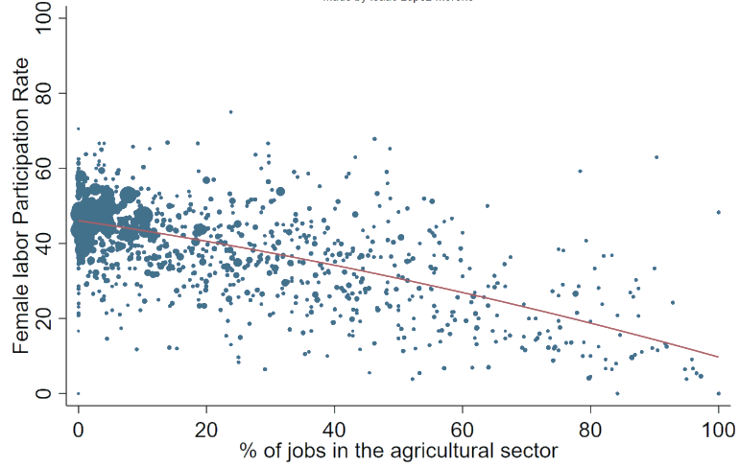
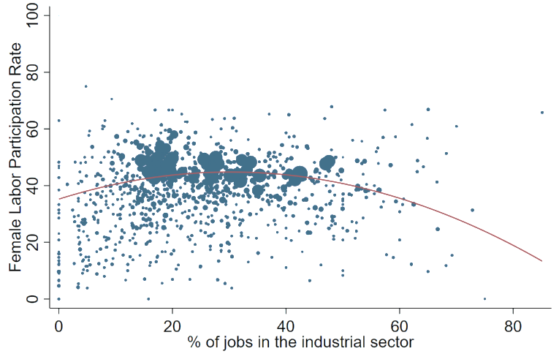
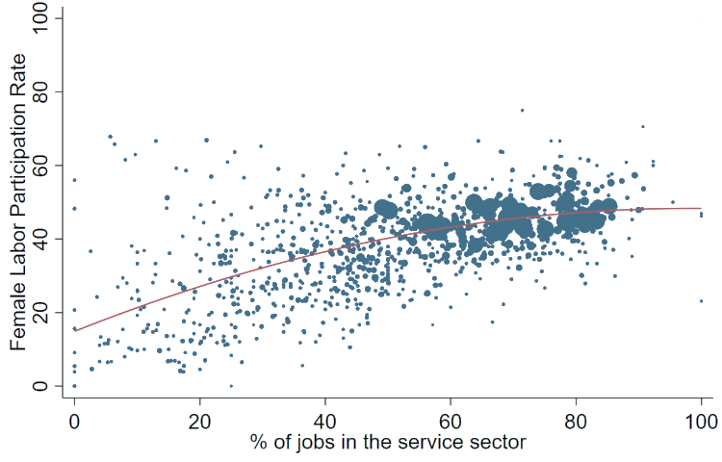
Mexican states
Note: The size of the dots varies depending on the total population in each state.
Mexican municipalities
Note: The size of the dots varies depending on the total number of surveys carried out in each municipality.

Slide 28
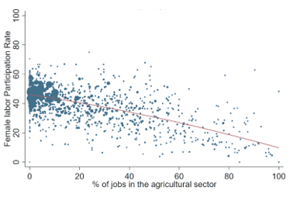
FLPR and % of jobs in agriculture in Mexican municipalities (2019, Q1)

Slide 29

FLPR and % of jobs in industry in Mexican municipalities (2019, Q1)

Slide 30
FLPR and % of jobs in services in Mexican municipalities (2019, Q1)

Slide 31
Econometric Model

Slide 32
Econometric Model
$$Y_{i,m,t}=β_{0}+β_{1}{Share}_{s, m,t}+ β_{x} X_{i,m,t}^{′}+β_{x} {HH}_{i,t}^{′}+β_{x} θ_{m,t}^{′}+ μ_{e, t} +ε_{i}$$

Slide 33
Econometric Model
$$Y_{i,m,t}=β_{0}+β_{1}{Share}_{s, m,t}+ β_{x} X_{i,m,t}^{′}+β_{x} {HH}_{i,t}^{′}+β_{x} θ_{m,t}^{′}+ μ_{e, t} +ε_{i}$$
“Y” is a binary variable that captures if the individual is part of the economically active population or not. This is the dependent variable of the model, and it takes value of 1 if a woman is economically active, and 0 if they are part of the non-economically active population. According to both the International Labour Organization and INEGI, the labour force participation rate should be estimated by considering individuals who are over 15 years old.

Slide 34
Econometric Model
$$Y_{i,m,t}=β_{0}+β_{1}{Share}_{s, m,t}+ β_{x} X_{i,m,t}^{′}+β_{x} {HH}_{i,t}^{′}+β_{x} θ_{m,t}^{′}+ μ_{e, t} +ε_{i}$$
“Share” is the main independent variable of the model, and it captures the percentage of jobs either in agriculture, industry, or services as a share of total employment in each municipality at a certain year.

Slide 35
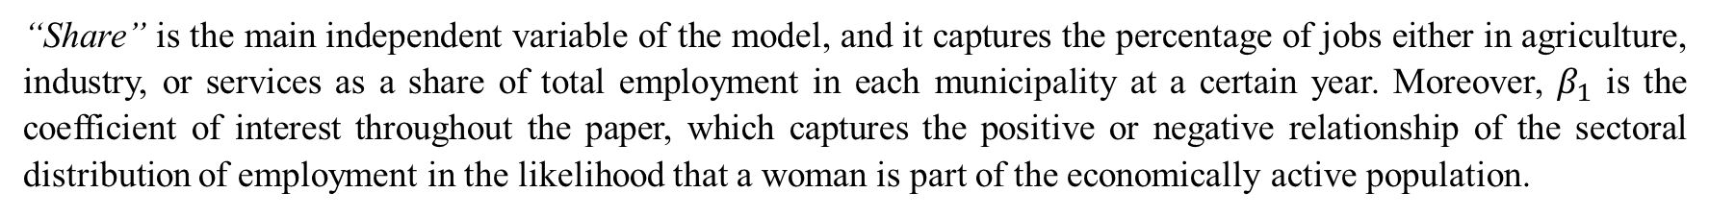
Econometric Model
$$Y_{i,m,t}=β_{0}+β_{1}{Share}_{s, m,t}+ β_{x} X_{i,m,t}^{′}+β_{x} {HH}_{i,t}^{′}+β_{x} θ_{m,t}^{′}+ μ_{e, t} +ε_{i}$$
“Share” is the main independent variable of the model, and it captures the percentage of jobs either in agriculture, industry, or services as a share of total employment in each municipality at a certain year. Moreover, $β_{1}$ is the coefficient of interest throughout the paper, which captures the positive or negative relationship of the sectoral distribution of employment in the likelihood that a woman is part of the economically active population.

Slide 36
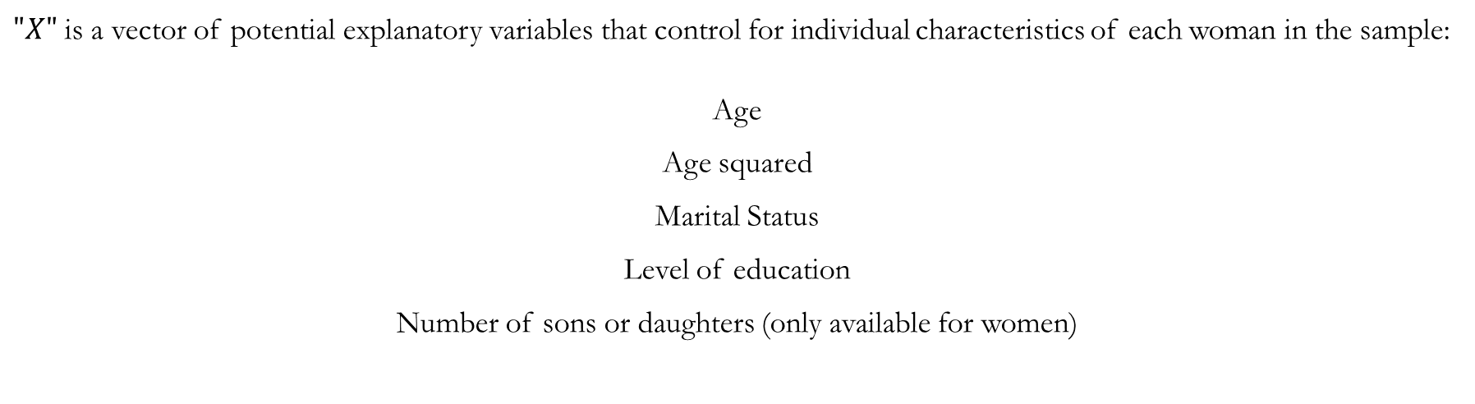
Econometric Model
$$Y_{i,m,t}=β_{0}+β_{1}{Share}_{s, m,t}+ β_{x} X_{i,m,t}^{′}+β_{x} {HH}_{i,t}^{′}+β_{x} θ_{m,t}^{′}+ μ_{e, t} +ε_{i}$$
$"X"$ is a vector of potential explanatory variables that control for individual characteristics of each woman in the sample:
Age
Age squared
Marital Status
Level of education
Number of sons or daughters (only available for women)

Slide 37
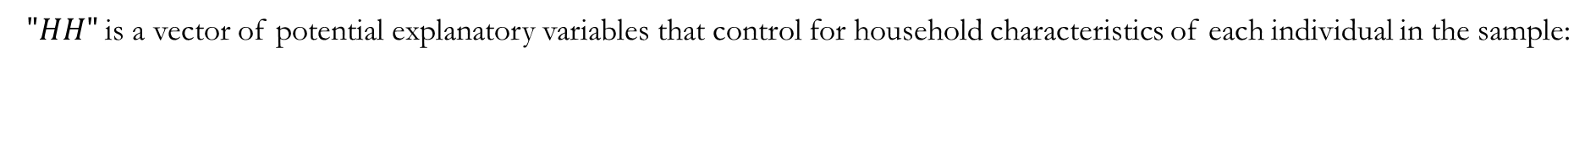
Econometric Model
$$Y_{i,m,t}=β_{0}+β_{1}{Share}_{s, m,t}+ β_{x} X_{i,m,t}^{′}+β_{x} {HH}_{i,t}^{′}+β_{x} θ_{m,t}^{′}+ μ_{e, t} +ε_{i}$$
$"HH"$ is a vector of potential explanatory variables that control for household characteristics of each individual in the sample:
Household characteristics:
Socio-Economic Stratum of the household
Kids below 5 years old in the household
Total of household members
Household head characteristics:
Sex of the household head
Age of the household head
Level of education of the household head

Slide 38
Econometric Model
$$Y_{i,m,t}=β_{0}+β_{1}{Share}_{s, m,t}+ β_{x} X_{i,m,t}^{′}+β_{x} {HH}_{i,t}^{′}+β_{x} θ_{m,t}^{′}+ μ_{e, t} +ε_{i}$$
“$θ"$ is a vector of control variables that captures different “location” characteristics of different Mexican municipalities
Location characteristics:
Rural / Urban identificator
Population size of the locality
Municipal characteristics:
Percentage of jobs in agriculture/industry/services in each municipality (squared and divided by 100) (Included to control for potential non-linear relationships). % of people in the municipality that migrated from their city or home-town to keep or maintain their current job % of women in the municipality that are married or in a free-union relationship % of women in the municipality with elementary school or less % of women in the municipality with secondary school % of women in the municipality with high school % of women in the municipality that are single Average age of women in the municipality

Slide 39
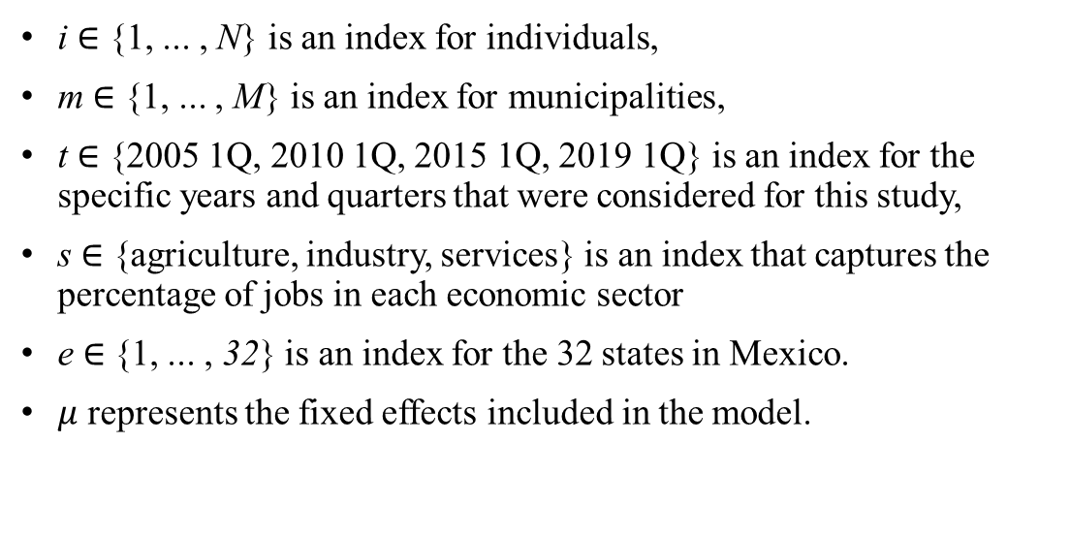
Econometric Model
$$Y_{i,m,t}=β_{0}+β_{1}{Share}_{s, m,t}+ β_{x} X_{i,m,t}^{′}+β_{x} {HH}_{i,t}^{′}+β_{x} θ_{m,t}^{′}+ μ_{e, t} +ε_{i}$$
i ∈ {1, ... , N} is an index for individuals,
m ∈ {1, ... , M} is an index for municipalities,
t ∈ {2005 1Q, 2010 1Q, 2015 1Q, 2019 1Q} is an index for the specific years and quarters that were considered for this study,
s ∈ {agriculture, industry, services} is an index that captures the percentage of jobs in each economic sector
e ∈ {1, ... , 32} is an index for the 32 states in Mexico.
$μ$ represents the fixed effects included in the model.

Slide 40
Missing control variables in the model
The presence of a teenage girl in the household.
The presence of an elderly person in the household.

Slide 41
Results

Slide 42
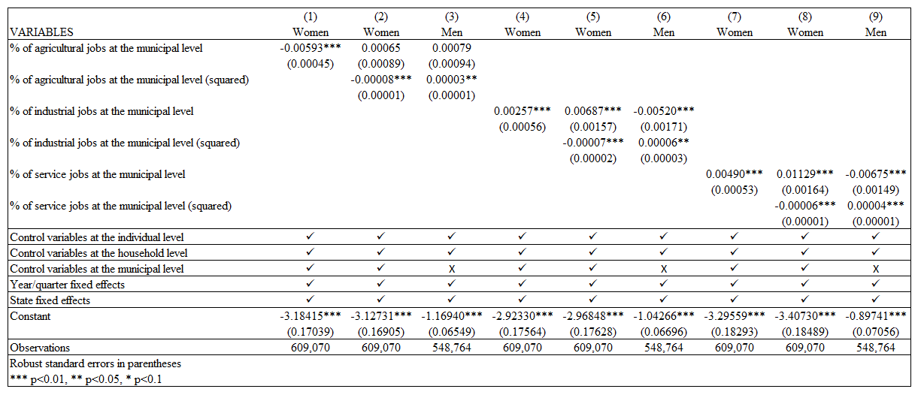
Likelihood of being economically active depending on sectoral distribution of employment and sex.

Slide 43
Average marginal probability of being economically estimated at the means of the covariates (depending on sex and the % of jobs in agriculture, industry, and services at the municipal level)
Results

Slide 46
MARGINSPLOT Graphical representation of the average marginal probability of being economically active depending on sex and the percentage of jobs in agriculture, industry and services (estimated at the means of the covariates)
Results

Slide 47
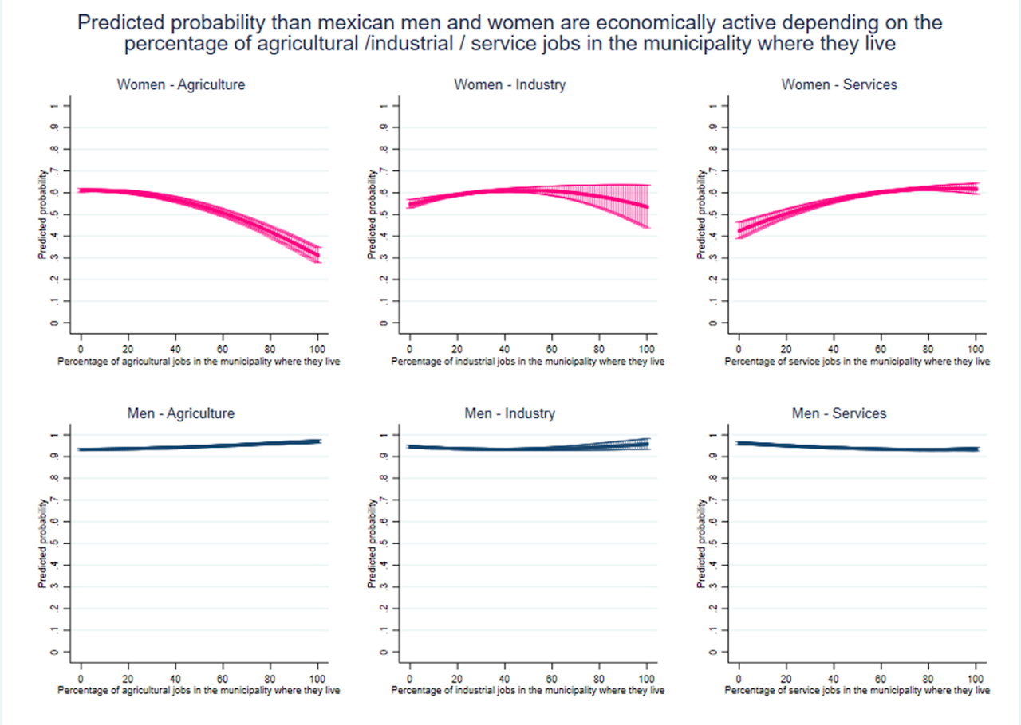

Slide 48
Robustness check
following the approach of Roncolato (2016)

Slide 49
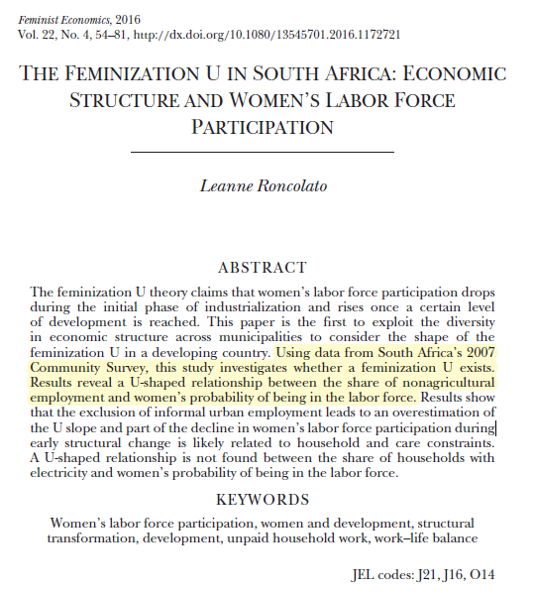

Slide 50
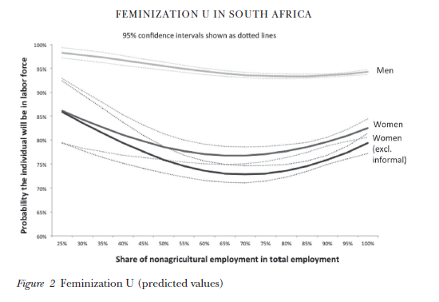
Results by Roncolato (2016)
She excluded urban informal employment to emulate earlier approaches of investigating the feminization
U, which utilized data that either omitted or underestimated informal
employment.
As she predicted, the exclusion of informal employment leads to
an overestimation of the feminization U.

Slide 51
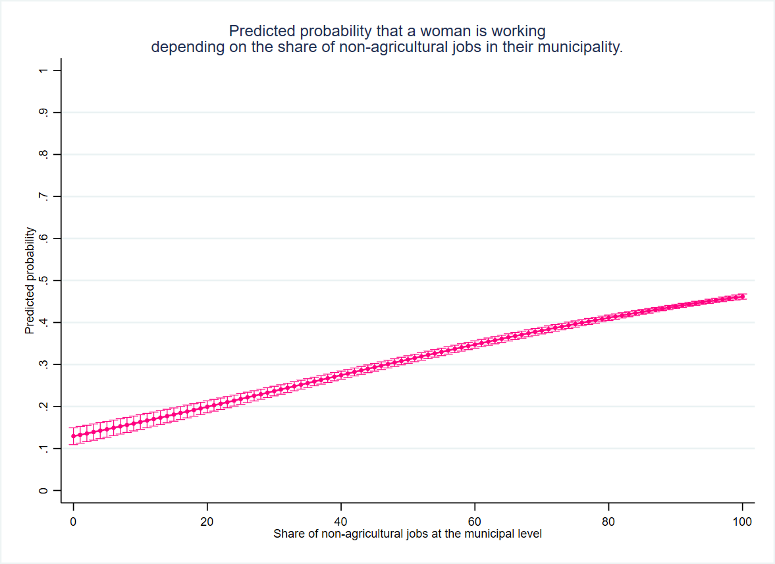
My results
In Mexico there is no U-shaped pattern between FLPRs and share of non-agricultural jobs at the municipal level.
There is a chance that Mexico followed a U-shaped pattern over time, but what is interesting is that during the 21st century, female labour participation is not lower in industrial regions of Mexico, but rather in the agricultural ones.

Slide 52
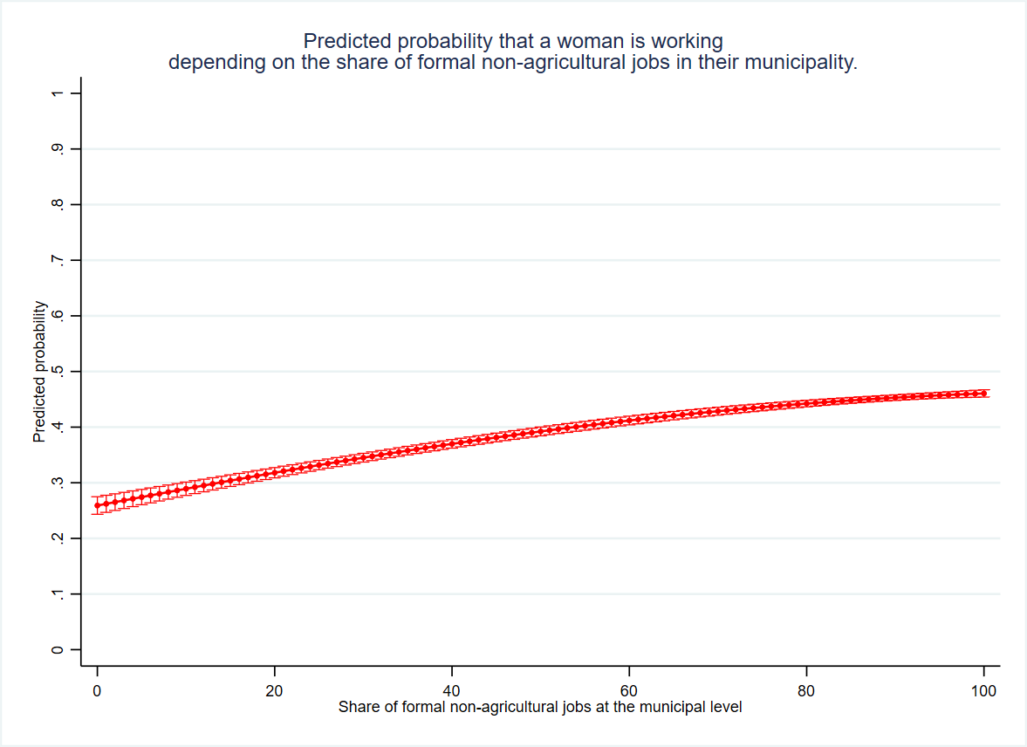
My results
These results were obtained after excluding informal employments in non-agricultural.
It was done just to follow the approach of Roncolato (2016), although it is not particularly relevant for my analysis.

Slide 53
Discussion of results

Slide 54
Discussion
It is understandable that women are less likely to be economically active in agricultural municipalities if we consider that only 10% of the total workforce in agriculture are women.
Source: Made by the author with data from the ENOE household survey.

Slide 55
Discussion
It is understandable that women are less likely to be economically active in agricultural municipalities if we consider that only 3.5% of economically active women are engaged in agriculture.
Source: Made by the author with data from the ENOE household survey.

Slide 56
Potential reasons behind the low participation of women in agricultural activities

Slide 57
Lack of labour demand

Slide 58
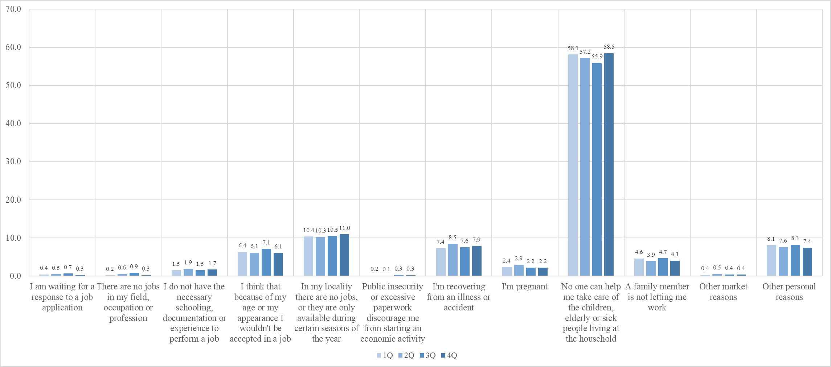
Reasons for not working among working-age women (18–65) who are engaged in domestic chores, Mexico (2019)

Slide 59
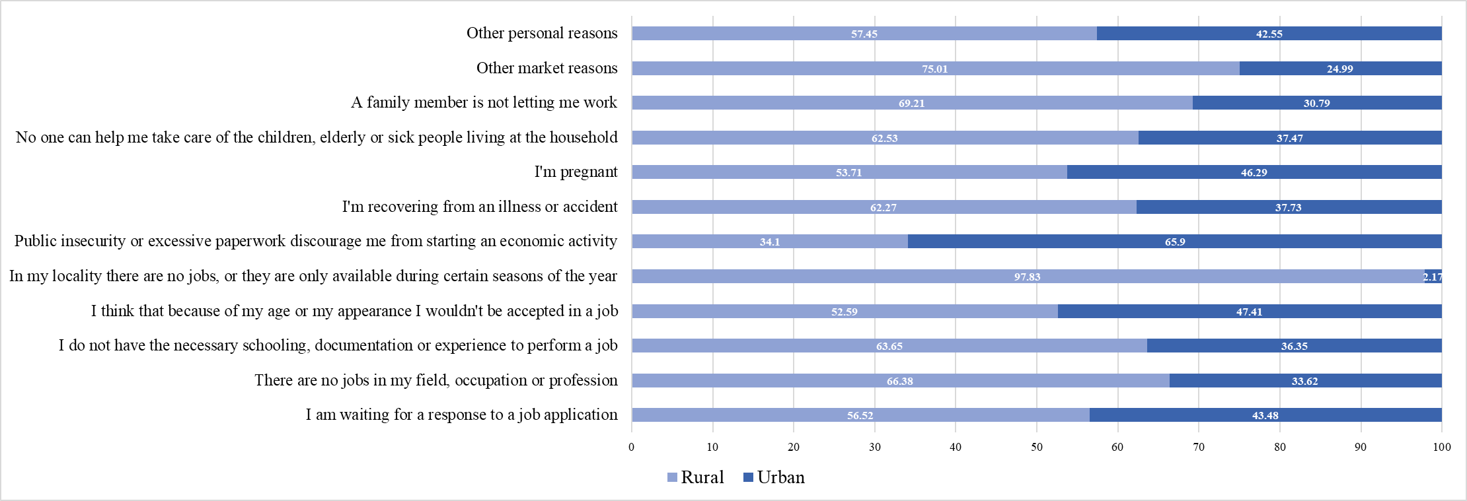
Reasons for not working among working-age women (18–65) engaged in domestic chores, differentiating by urban and rural areas (Mexico, first quarter of 2019)
This graph shows that most women answering that they are not working due to lack of labour demand are living in rural areas of Mexico

Slide 60
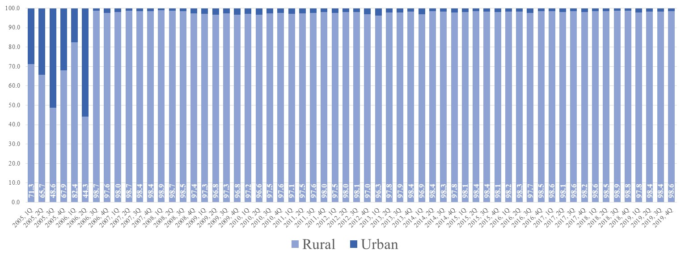
Non-working women due to lack of labour demand, differentiated by urban and rural areas (Mexico, 2005–2019)
This graph shows that across years, most women answering that they are not working due to lack of labour demand are living in rural areas of Mexico

Slide 61
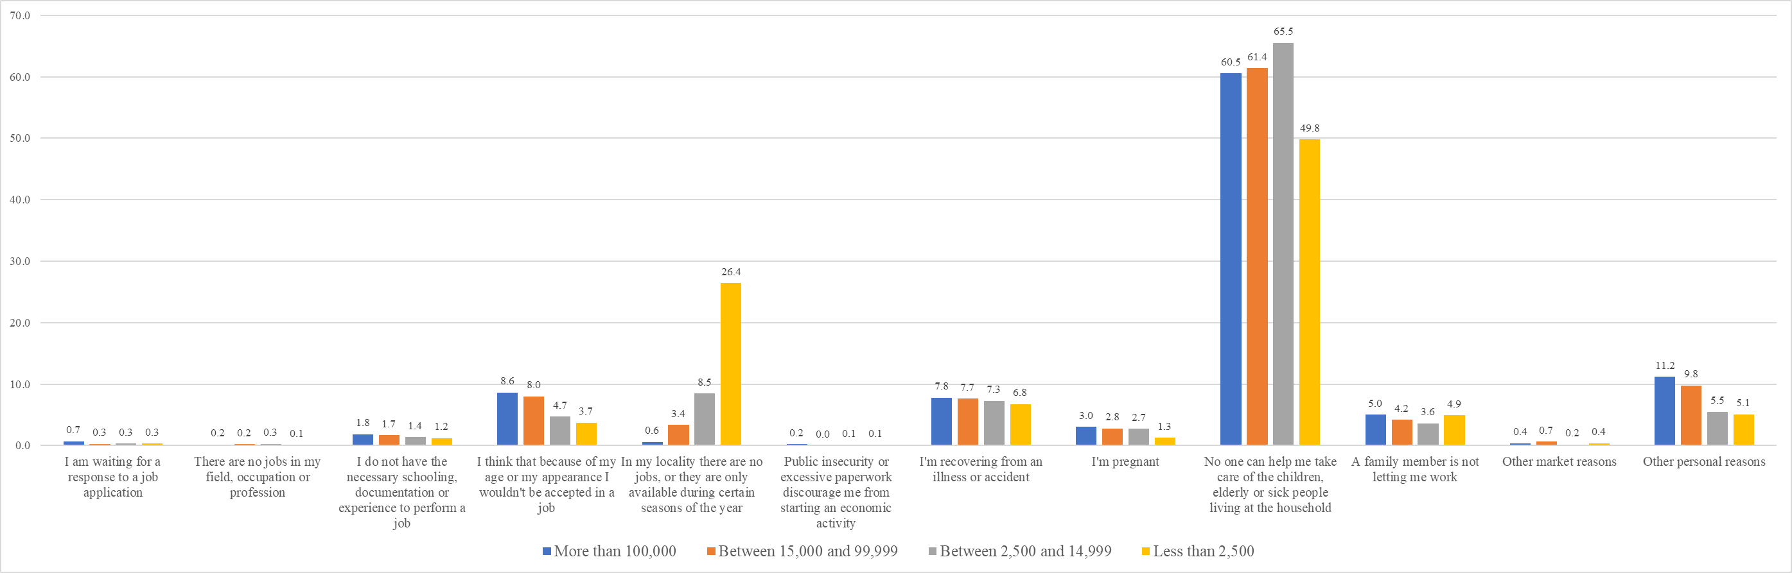
Reasons for not working among working-age women (18–65) engaged in domestic chores, differentiating by locality size (Mexico, first quarter of 2019)
Compared to the first figure of this subsection, this graph shows that in localities of Mexico with less than 2,500 inhabitants more than 25% of women are not working due to lack of labour demand.

Slide 62
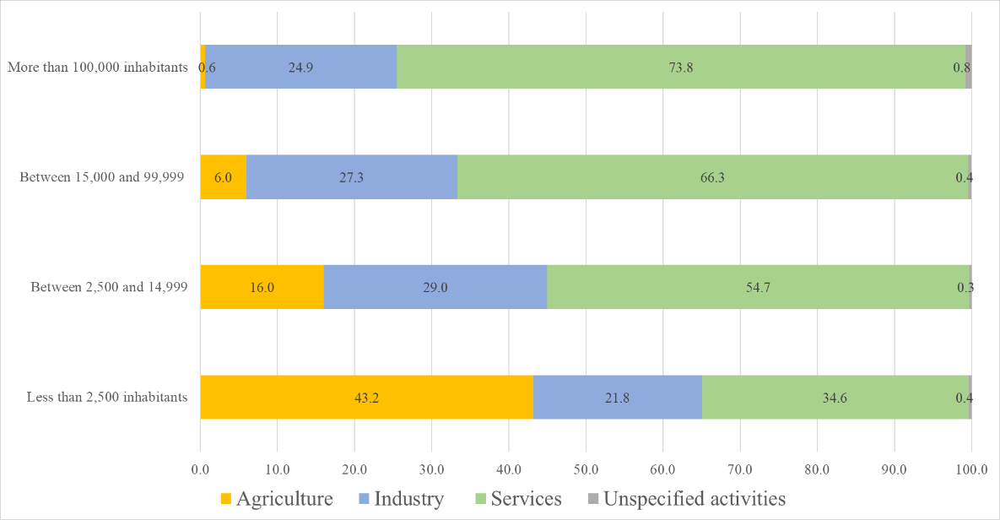
Sectoral distribution of employment depending on the population size of the locality (National average within Mexico, first quarter of 2019)
This figure shows the average size of the agricultural sector in Mexican localities with less than 2,500 inhabitants.
It indicates that in small Mexican localities, the average size of the agricultural sector is bigger than industry or services.

Slide 63
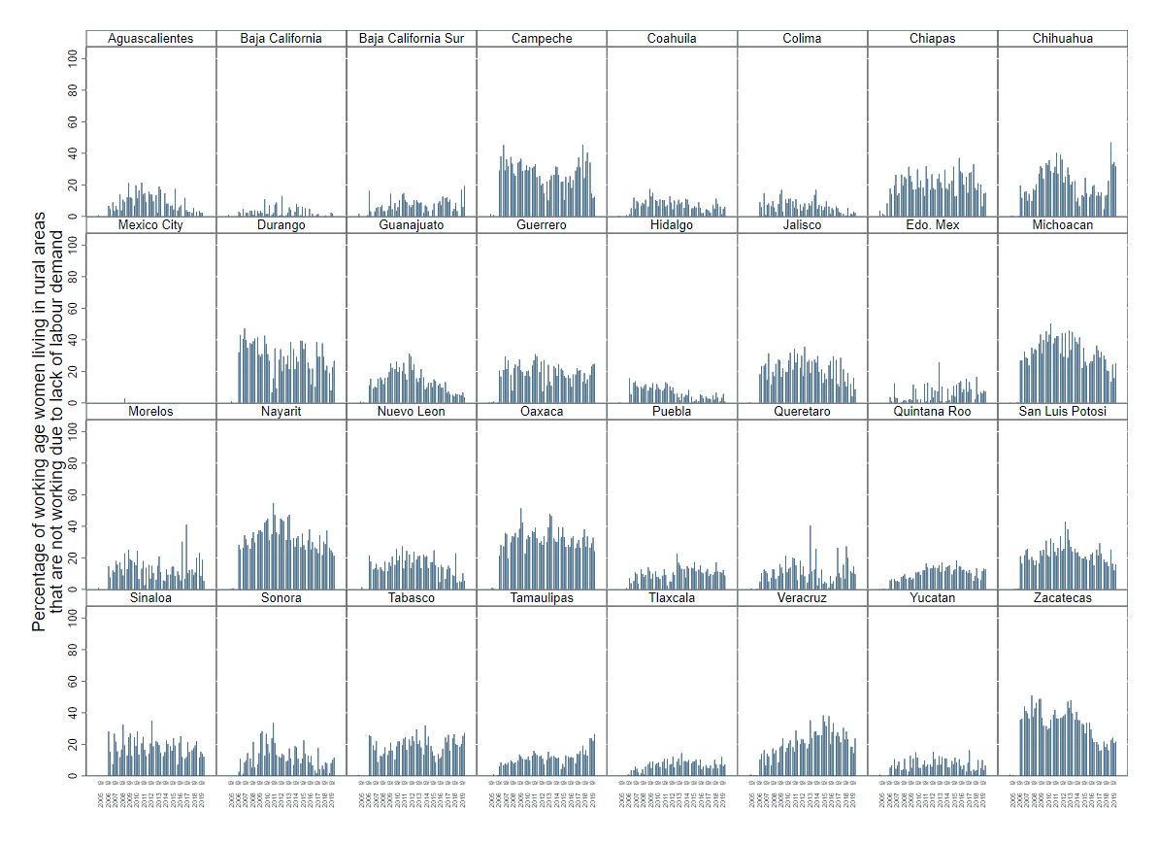
To conclude, this figure shows the percentage of women living in localities of Mexico with less than 2,500 inhabitants who indicated that they are not working due to lack of labour demand.
States like Michoacan, Oaxaca, and Nayarit are the ones where more women are not working due to lack of labour demand.

Slide 64
Thanks for your attention
Contact:
isaac.lopezmorenoflores@manchester.ac.uk

